Slide 1
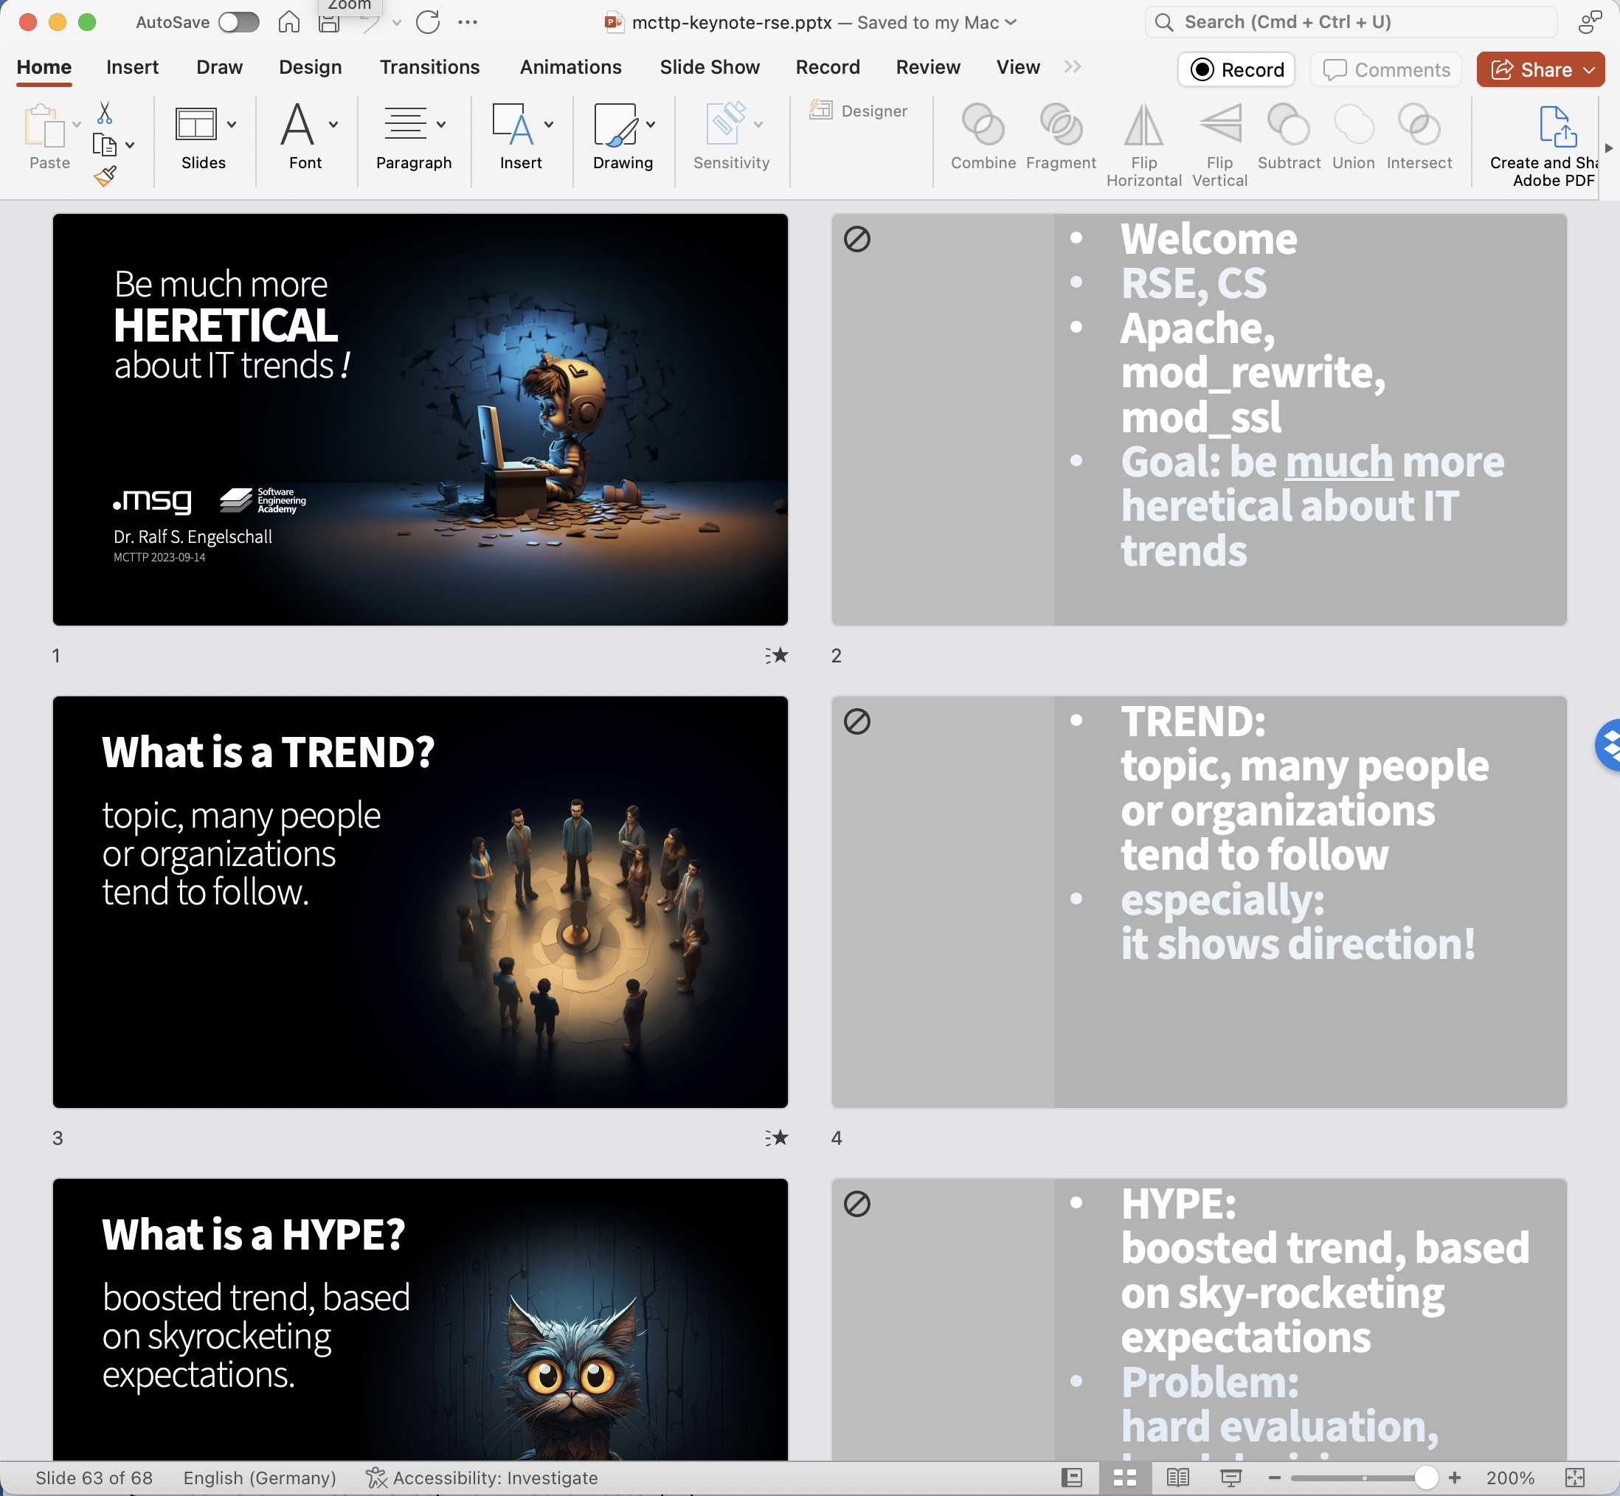
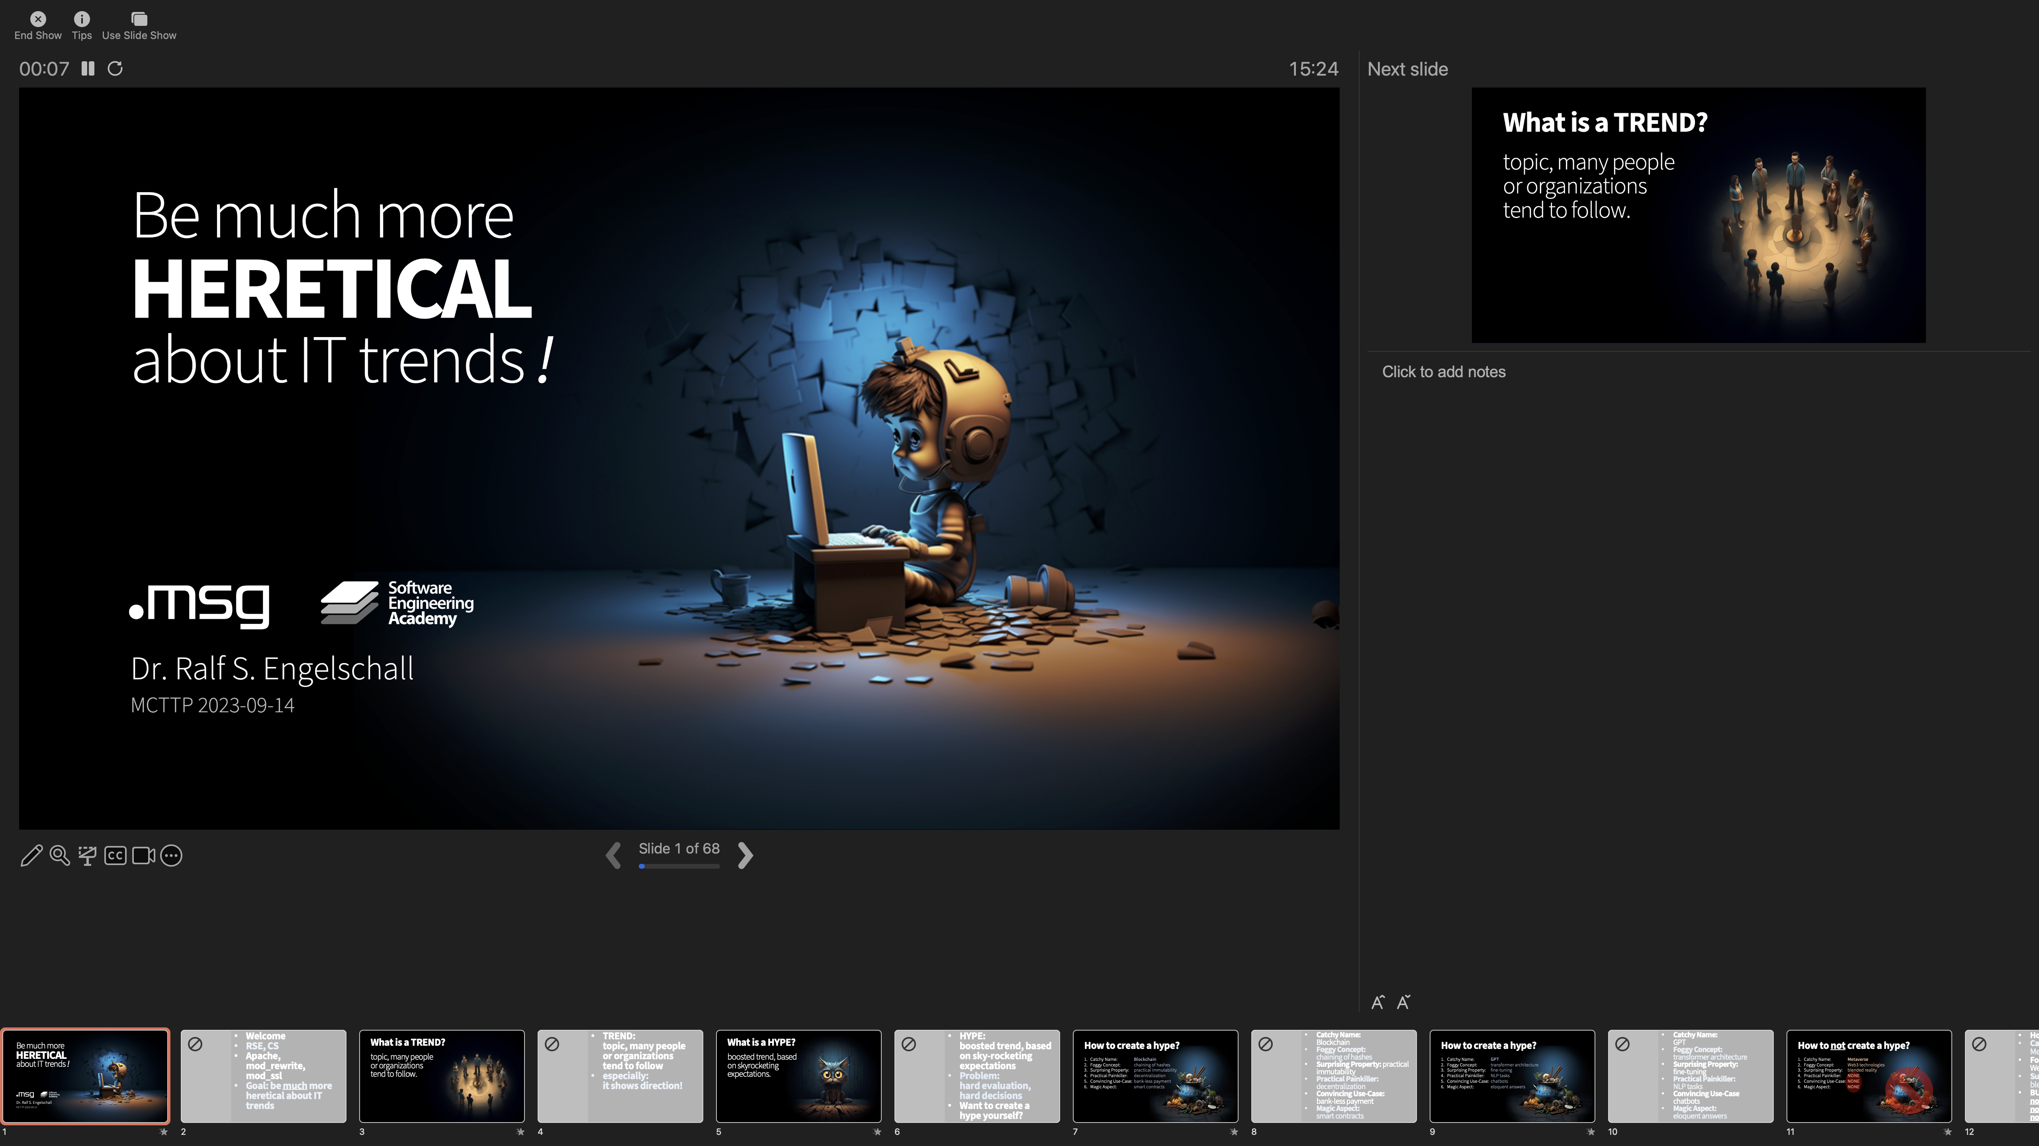


PowerPoint (editing view)
PowerPoint (slideshow view)
PowerPoint (presentation view)
PPTX-Promter

